Slide 1
TreeLOG
PUMA Team
CSIT 551
Montclair State University

Slide 2
Team Puma
Moaath Alrajab | Instructor
Members of the PUMA team Alphabetical order of the team members by First name. Equal contribution.
Eliezer Epstein | Classes and methods to work with Google Map and coordinates, related UI
Elion Limanaj | DB DAO's, user Auth, Auth related UI, location detection
Inga Gaidukova | UI, classes and methods for UI to DB integration
Supriya Karambe | Classes and methods to work with Photos, related UI
Zahid Aziz | DB DAO's, user Auth, Auth related UI

Slide 3
Contents
Introduction
Competitive Solutions
Approach to new Solution
Application –Workflow
Application – Activities in details
Improvement in Application
Limitations of Application
Future Work

Slide 4
Statement of the problem[1]
Part 1
Initial Municipal need. Submitter: Camden city.
In order to improve the quality of the City's street tree inventory, a more efficient way to survey and get baseline data on street trees would better manage risk, the health and growth of its canopy. Crowd sourcing capabilities are also needed. Currently, volunteers carry physical spreadsheets to catalogue a street tree location, health, general size, type, potential hazards. Some of that info is then uploaded to a Google Map.
The main purpose was to have the inventory of the trees is for getting grants that the city can use to replant certain areas and neighborhoods. The city should have a coverage of 20% with trees, but currently only have 8-9% coverage.

Slide 5
Statement of the problem [2]
Part 2
Conducted studies in the development process have shown that tree inventory involves more use than helping one community and includes several different goals and directions.
Specific problem inventory
Partial inventory
Complete inventory
Cover type inventory
A tree inventory may be conducted for many reasons:
urban forestry program
to prioritize tree maintenance needs
to plan for the community's future
to provide a basis for the implementation of a management plan

Slide 6
Initial data for searching competitive applications
Keywords: tree inventory, tree inventory app, tree hazard
Rating: all ratings
Price: paid and free
Promotion: Pay-Per-Click campaign or General catalog
Sources
AppStore
Google Play
Google Search results and AdWords

Slide 7
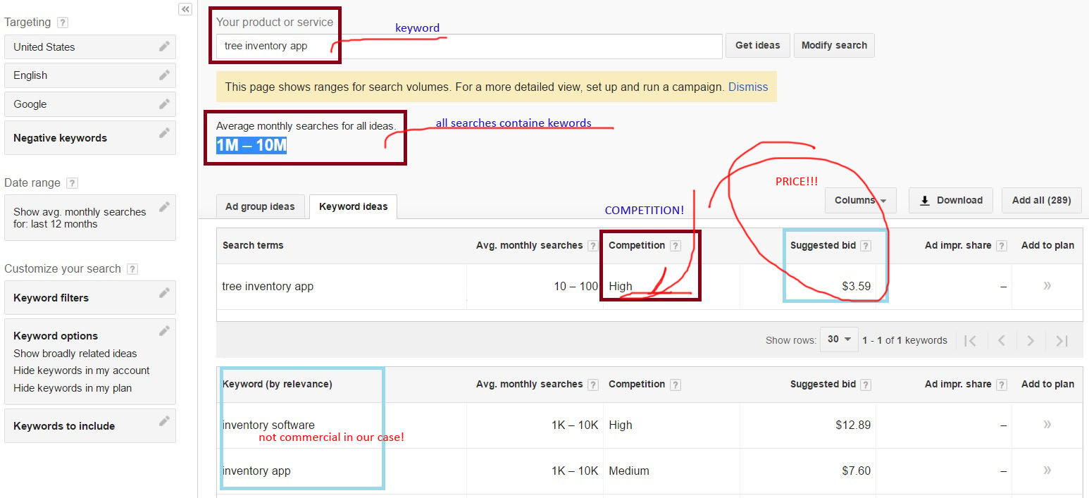
Why particular keywords and Pay-Per-Click sources

Slide 8
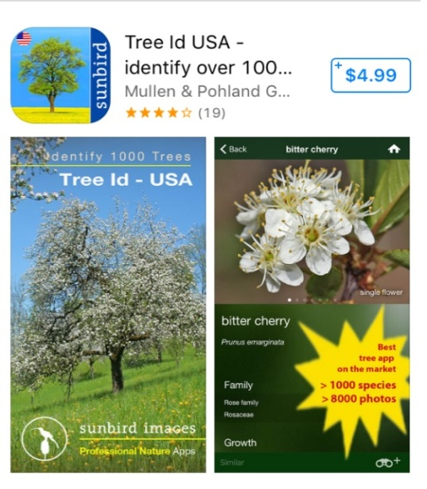
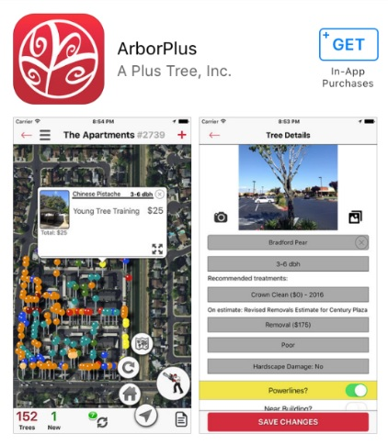
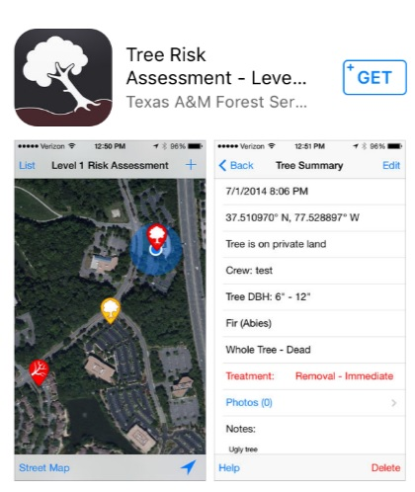
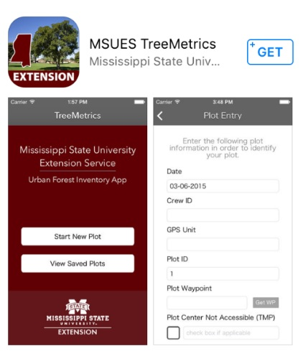
Competitive Solution AppStore
Has treatment recommendation and future alerts
Use cloud platform
Saving battery features
Well supported
Has start tour
Uses GPS technology
Tree recognition implemented by using step by step instructions
Easy start to use
Integrates several established standards, such as UFORE codes (tree species list), etc
Export to CVS
For knowledgeable users
Doesn't decode the street address
Based on plot definition, not tree description, which can lead to not including street trees
Connected to GIS
Can make exports to external files
Related to inventory
Probably not supported
Questionable usability

Slide 9
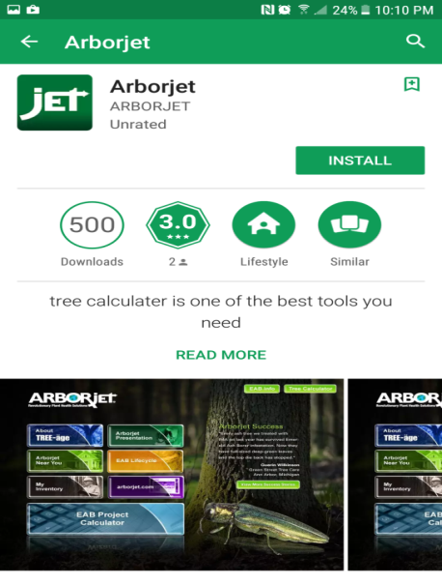
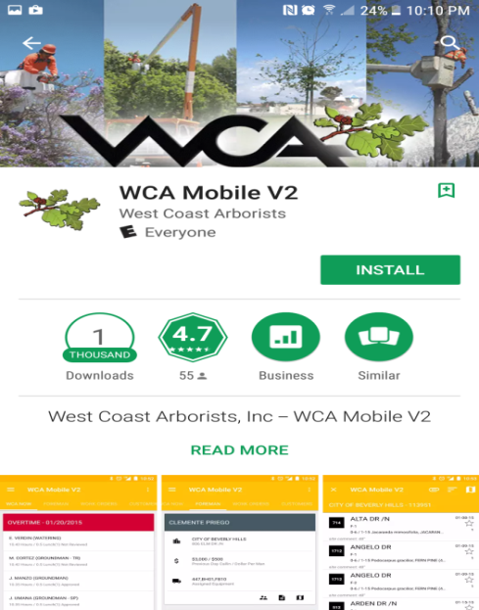
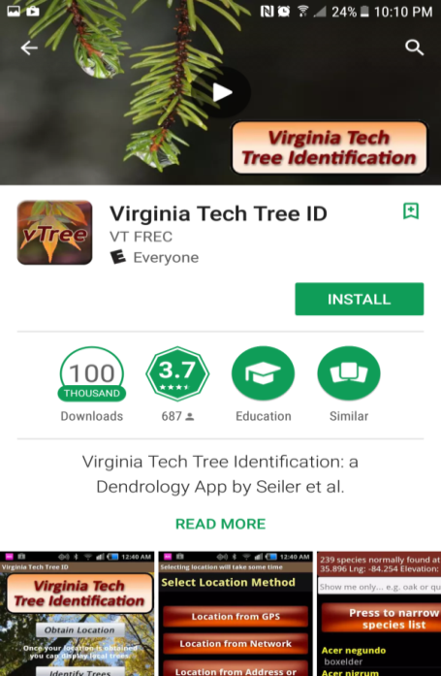
Competitive Solution Google Play
Asked for managing phone calls, after denying could not configure the installation process.
Not all buttons work on the main menu
My inventory doesn't work
The application mainly works as a portal for a chemical solution for tree health
Step by step tree recognition
Database of picture takes a lot of space on Smartphone

Slide 10
Competitive Solution: Google Search and Social Media
No distributing the tree inventory applications websites that were found by the results of Organic search
No supporting active pages from Social Media were found (Facebook)
One distributing the tree inventory applications websites that were found by the results of PPC campaign
Name: Tree Plotter
Price: Extrimely High
Pros and Cons are not available for exploring (ships with customized configuration)

Slide 11
Initial Solution
Multi user Mobile application which locates GPS coordinates on the field, allows to save description of the tree in the database with photo making and leaves recognition capabilities for Android platform devices.

Slide 12
Initial Objectives
Function | Action
Track GPS location of the tree | Will mark the coordinates of the tree and save to the database
Photo uploading capabilities | Will use phone's camera to make picture in the application interface with option to save in the database
Identify hazards | Will use preset data for usability and identifying a level of the hazard for future actions.
Storing all tree related data in database | All data will be saved in a database
Login options (regular, google+) | Will allow to use the application

Slide 13
Functionality at the final phase and limitations according to the specification
Function | Implemented
Track GPS location of the tree | Done
Identifying type of the tree | Not implemented
Photo uploading capabilities | Done
Identify hazards | Done
Storing all tree related data in database | Done
Login options (regular, facebook, google+) | Done (regular, google)
Administrator of the application | Not implemented

Slide 14
Target Users and Audience
Initial Users
Volunteers from Sustainable Camden County Municipality, who are mapping trees, are the future users of the application. The Application will be created for the devices with Android platform.
Perspective Users
Small town municipalities
Departments of parks and recreation (ex. New York City Department of Parks & Recreation )
Landscape companies and designers
Golf clubs
Medical centers and rehabilitations
Large estates to maintain landscape
etc.

Slide 15
Application Workflow
New Tree
Tree List in Area
Make photo
Map
Log Out
Exit
Login
Welcome Page

Slide 16
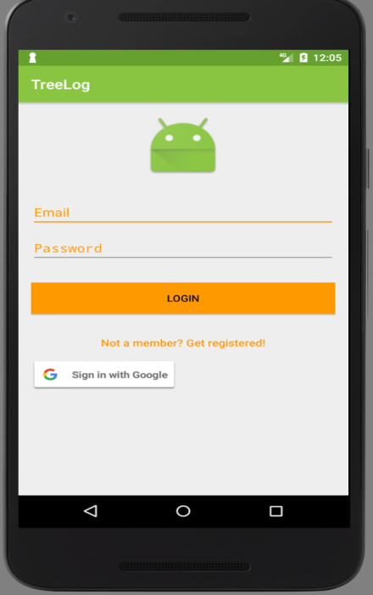
Login Activity
User Can Login Using 2ways 1. Regular Email id and Password. 2. User can use his /her existing google id and password If user is not registered , he will go to Registration Activity

Slide 17
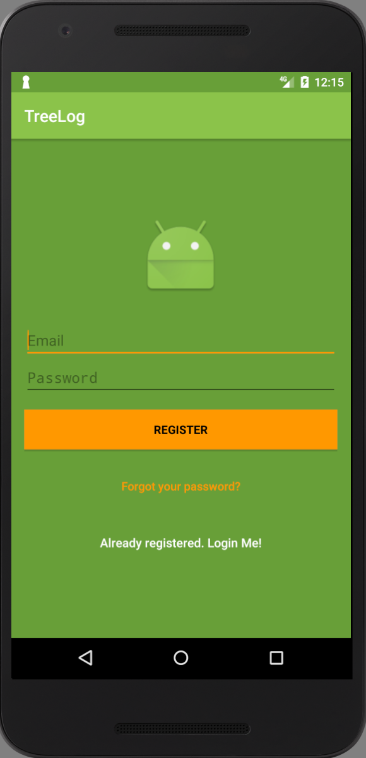
Registration Activity
 | User can register, using email id and password . Once he entered email and password, he will able to login TreeLog app, using regular login email id.

Slide 18
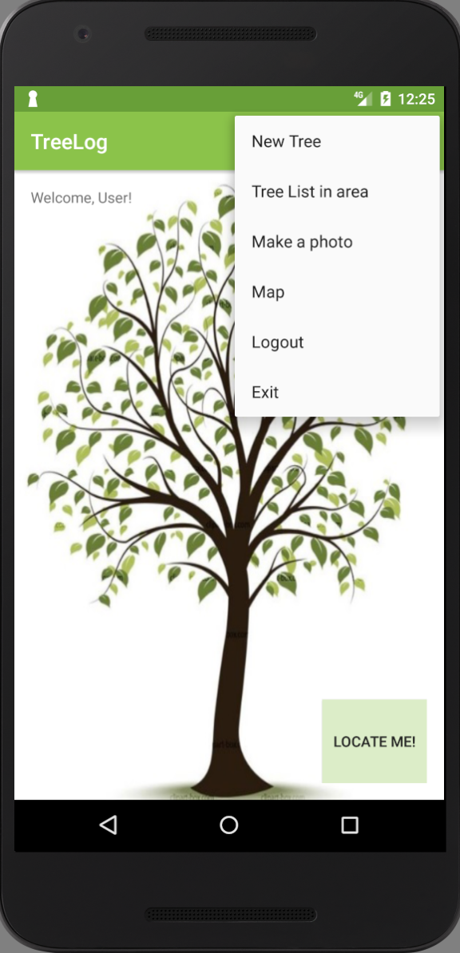
Welcome Activity
Once User logged in he can see Welcome Screen There are menu available to do different activity related to Tree. 1.New Tree 2.Tree List in Area 3.Make a photo 4.Map 5.Logout 6. Exit

Slide 19
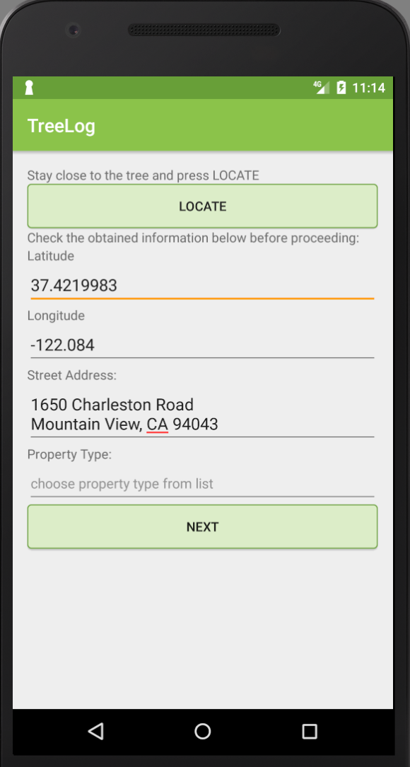
New Tree
 | User can create new tree in database using this New Tree. Locate button- Shows the geo coordination of tree which is nearby. Or user can add manually Latitude, longitude, Street of that tree. Property field - private or public property. Continue…

Slide 20
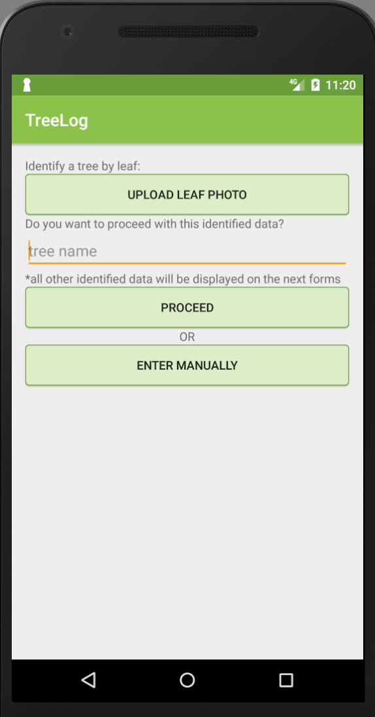
User can add Tree name. There are two option- 1. User can proceed with information fetched form database. 2.He can add add manually information of tree.

Slide 21
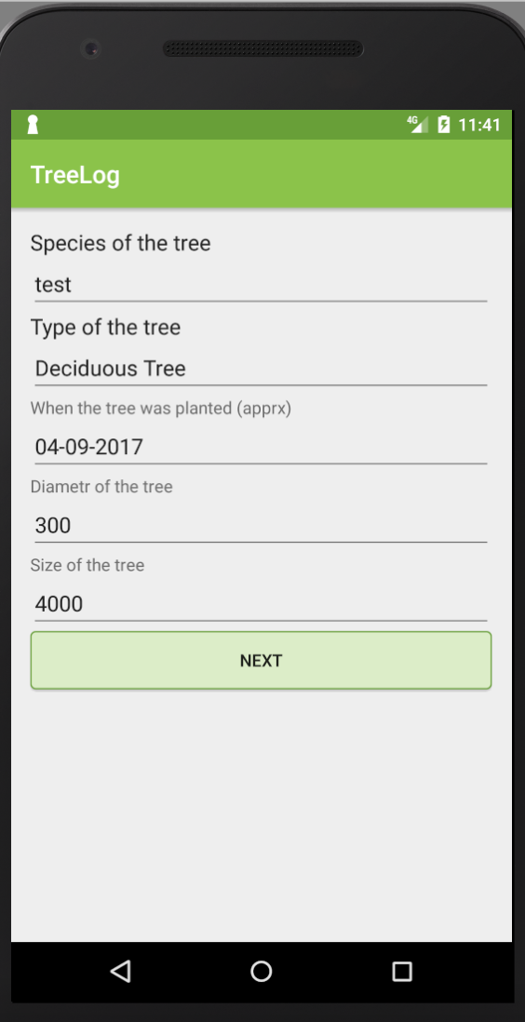
TreeData(Draft)
 | Here we will add video --- As To save Tree data we are having 4-5 slides..

Slide 22
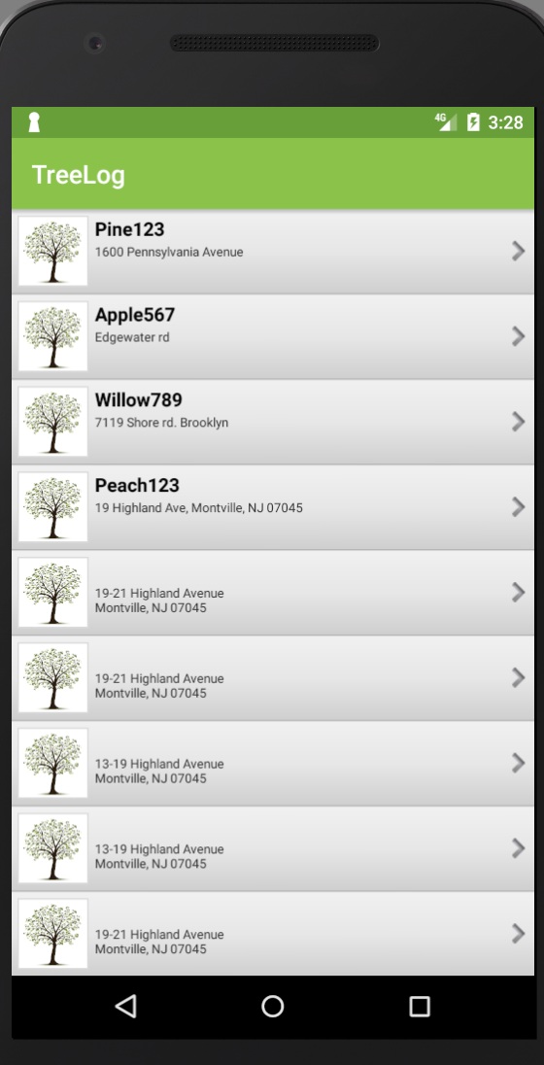
Tree List in Area
Tree List in Area Menu displays all available trees in that particular area. User can click on any tree from list to get details of that tree.

Slide 23
Technologies Used
Android Studio
GithHub
Firebase Database
Google Play Services (Google Location, Google Maps)

Slide 24
Firebase Database
Faced Problems
Lessons learned

Slide 25
Google Location
Faced Problems
Lessons learned

Slide 26
Google Maps
Faced Problems
Lessons learned

Slide 27
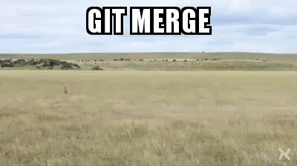
GitHub

Slide 28
Short term perspectives
User Interface improvement, such as integration with existed database of species in Northern America and step by step tree recognition by using this database.
User Interface improvement by adding a tutorial how to use the application and glossary.
Integration with binominal nomenclature (formal system of naming species of living things by giving each a name composed of two parts, both of which use Latin grammatical forms)
Classification of all types damages (biotic or abiotic) and creation different levels of awareness for treatment suggestions or immediate removal
Export data to *.cvs file for client's needs analysis
Build iOS version of TreeLOG application

Slide 29
Long term perspectives
Integration with Tree Planting Standards. This document includes Design requirements, Plan Pest Control requirements, Materials, Planting specification, Seasonal Maintenance. By integrating all the standards with different levels of awareness we will get full inventory with prioritized suggestions for trees maintenance.
Approximated costs or a particular contractor's cost of the different types of maintains could be added into the application. Integration with obtained inventory with prioritized suggestions will improve budget management.
Integration with existed client's database.
More comprehensive User Interface using Image processing algorithms not only for species recognition but shape, sizes, distance in between trees, etc.

Slide 30
DRAFT Why to promote?
Users
Demand
Marketing plan
NUMBERS???

Slide 31

THANK YOU!

